Slide 1
Modeling Results
Saqib Rizvi

Slide 2
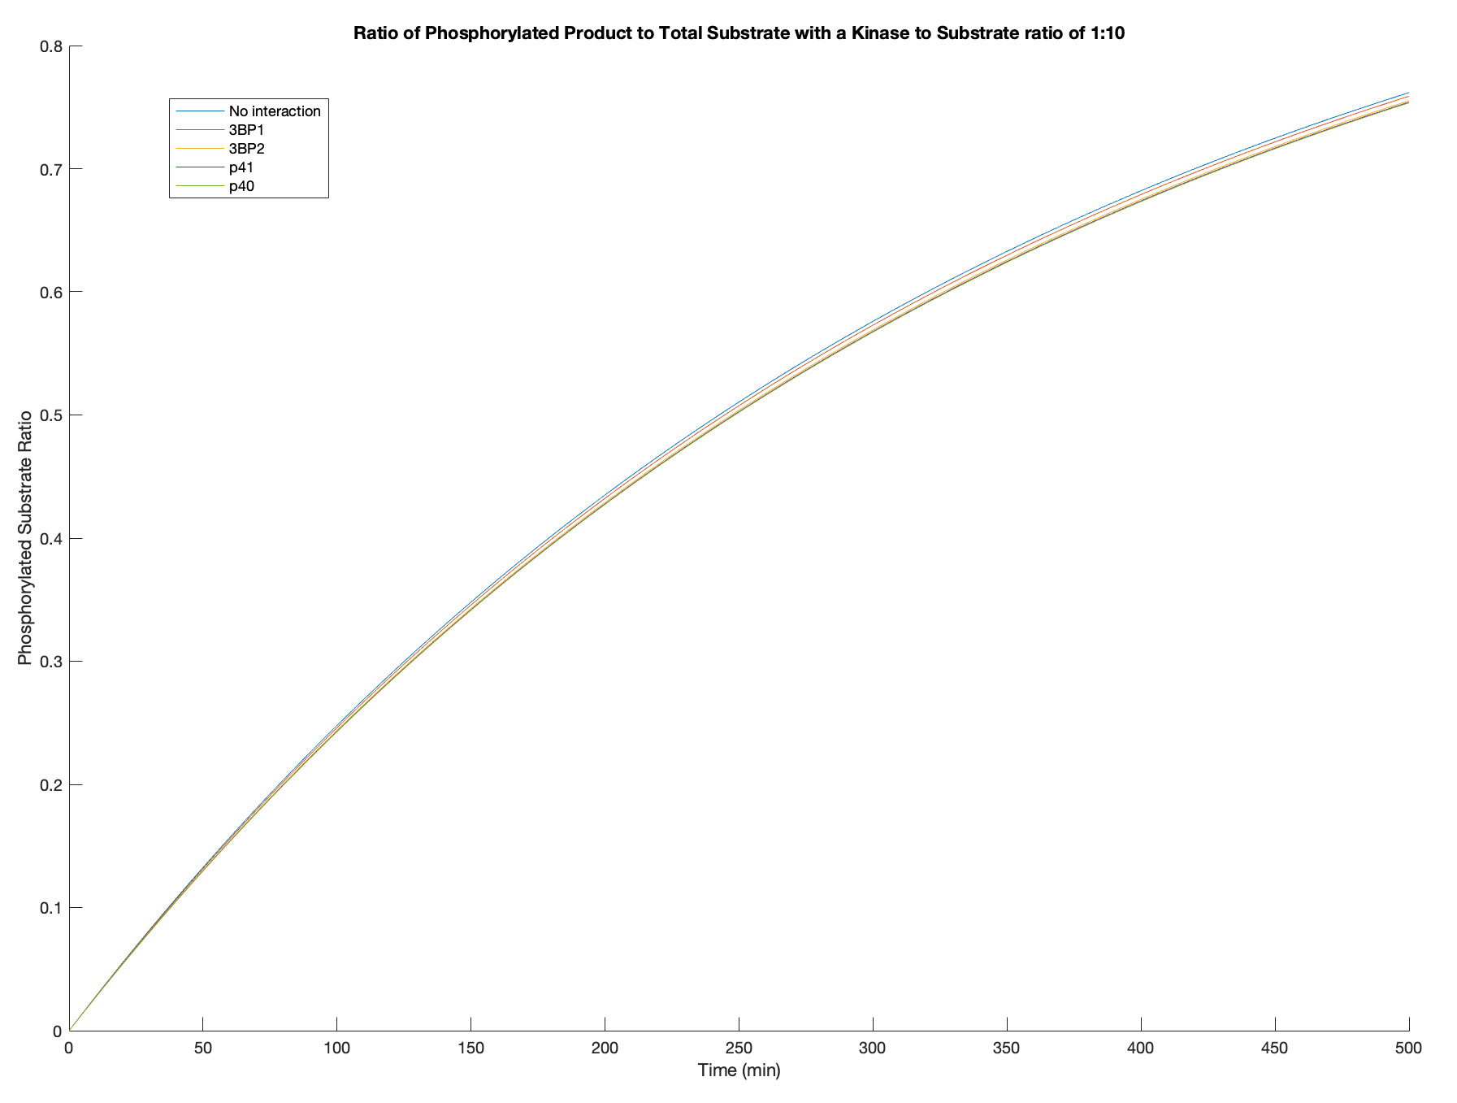
Summary of Results
Same trend is seen in all except for 1:10 where its reversed
My guess is that this is a function of kcat
Trend:
P40>p41>3BP2>3BP1>No Interaction
As kinase to substrate ratio decreases, phosphorylated ratio decreases
At high kinase to substrate ratio, a logarithmic curve is observed
The graphs of the different secondary interactions don’t seem to differ by much

Slide 3
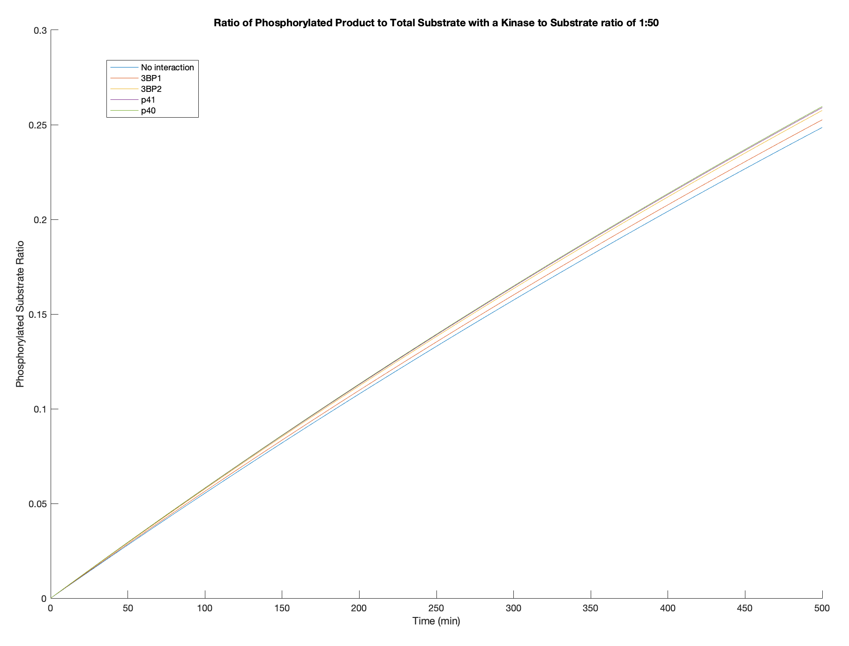
Summary of Results
Same trend is seen in all except for 1:10 where its reversed
My guess is that this is a function of kcat
Trend:
P40>p41>3BP2>3BP1>No Interaction
As kinase to substrate ratio decreases, phosphorylated ratio decreases
At high kinase to substrate ratio, a logarithmic curve is observed
The graphs of the different secondary interactions don’t seem to differ by much

Slide 4
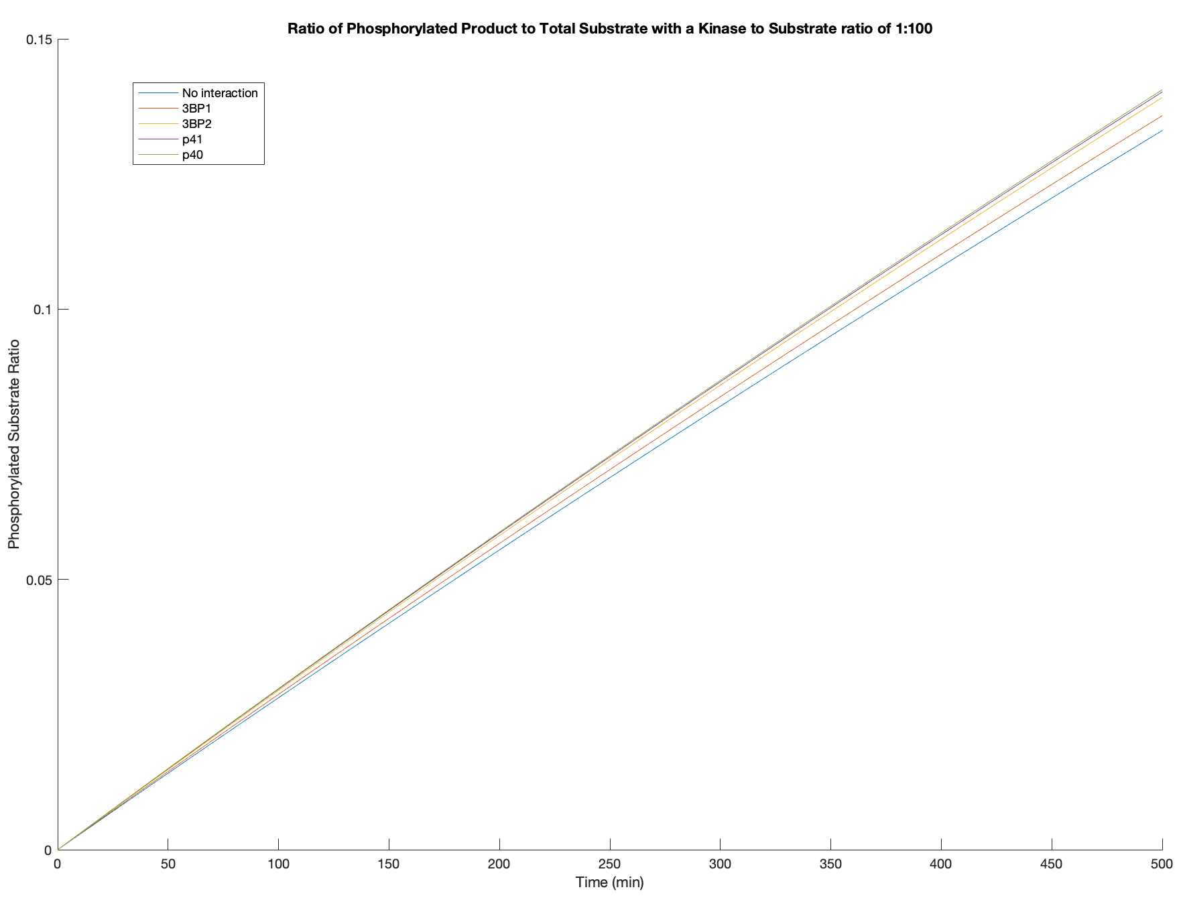
Summary of Results
Same trend is seen in all except for 1:10 where its reversed
My guess is that this is a function of kcat
Trend:
P40>p41>3BP2>3BP1>No Interaction
As kinase to substrate ratio decreases, phosphorylated ratio decreases
At high kinase to substrate ratio, a logarithmic curve is observed
The graphs of the different secondary interactions don’t seem to differ by much

Slide 5
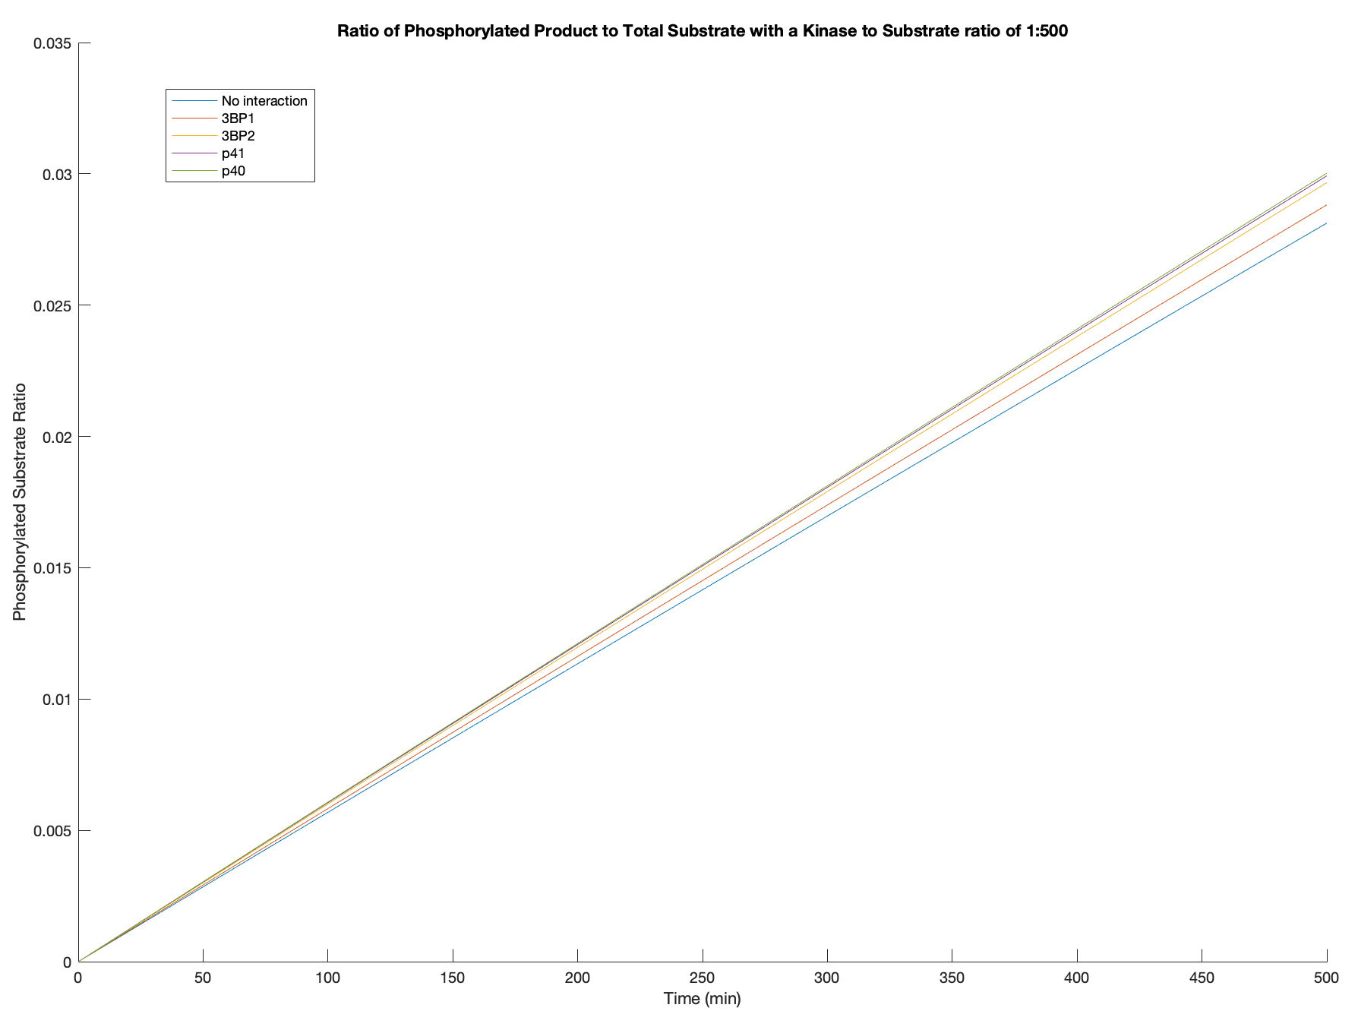
Summary of Results
Same trend is seen in all except for 1:10 where its reversed
My guess is that this is a function of kcat
Trend:
P40>p41>3BP2>3BP1>No Interaction
As kinase to substrate ratio decreases, phosphorylated ratio decreases
At high kinase to substrate ratio, a logarithmic curve is observed
The graphs of the different secondary interactions don’t seem to differ by much

Slide 6
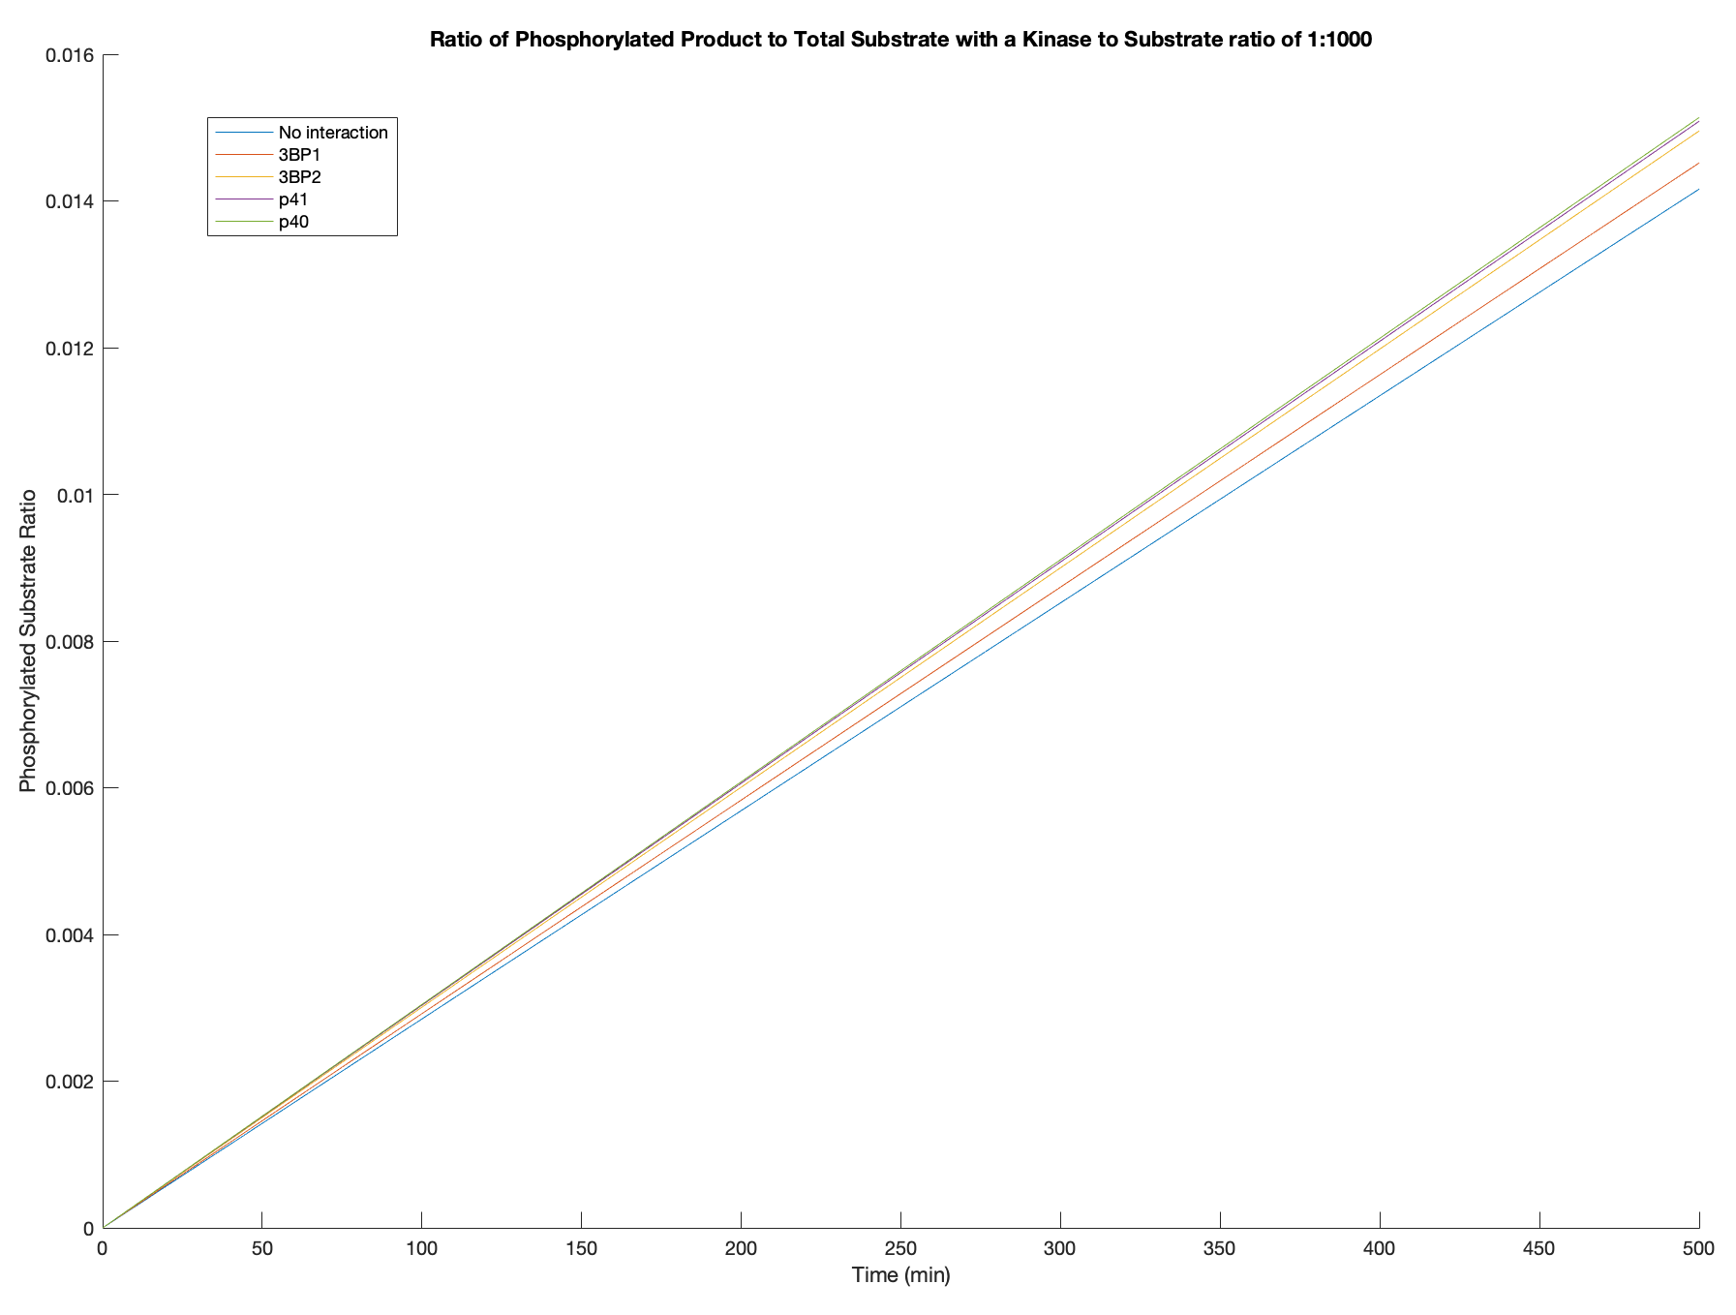
Summary of Results
Same trend is seen in all except for 1:10 where its reversed
My guess is that this is a function of kcat
Trend:
P40>p41>3BP2>3BP1>No Interaction
As kinase to substrate ratio decreases, phosphorylated ratio decreases
At high kinase to substrate ratio, a logarithmic curve is observed
The graphs of the different secondary interactions don’t seem to differ by much

Slide 7
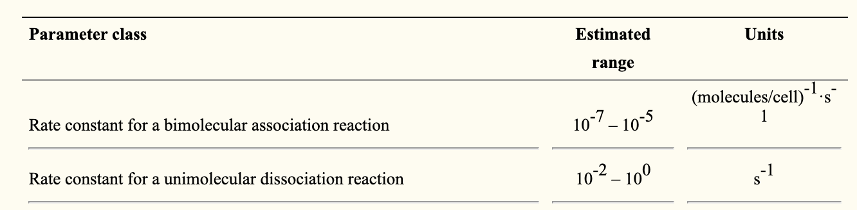
Ranges of values for association and dissociation constants
Creamer et al. (2012)

Slide 8
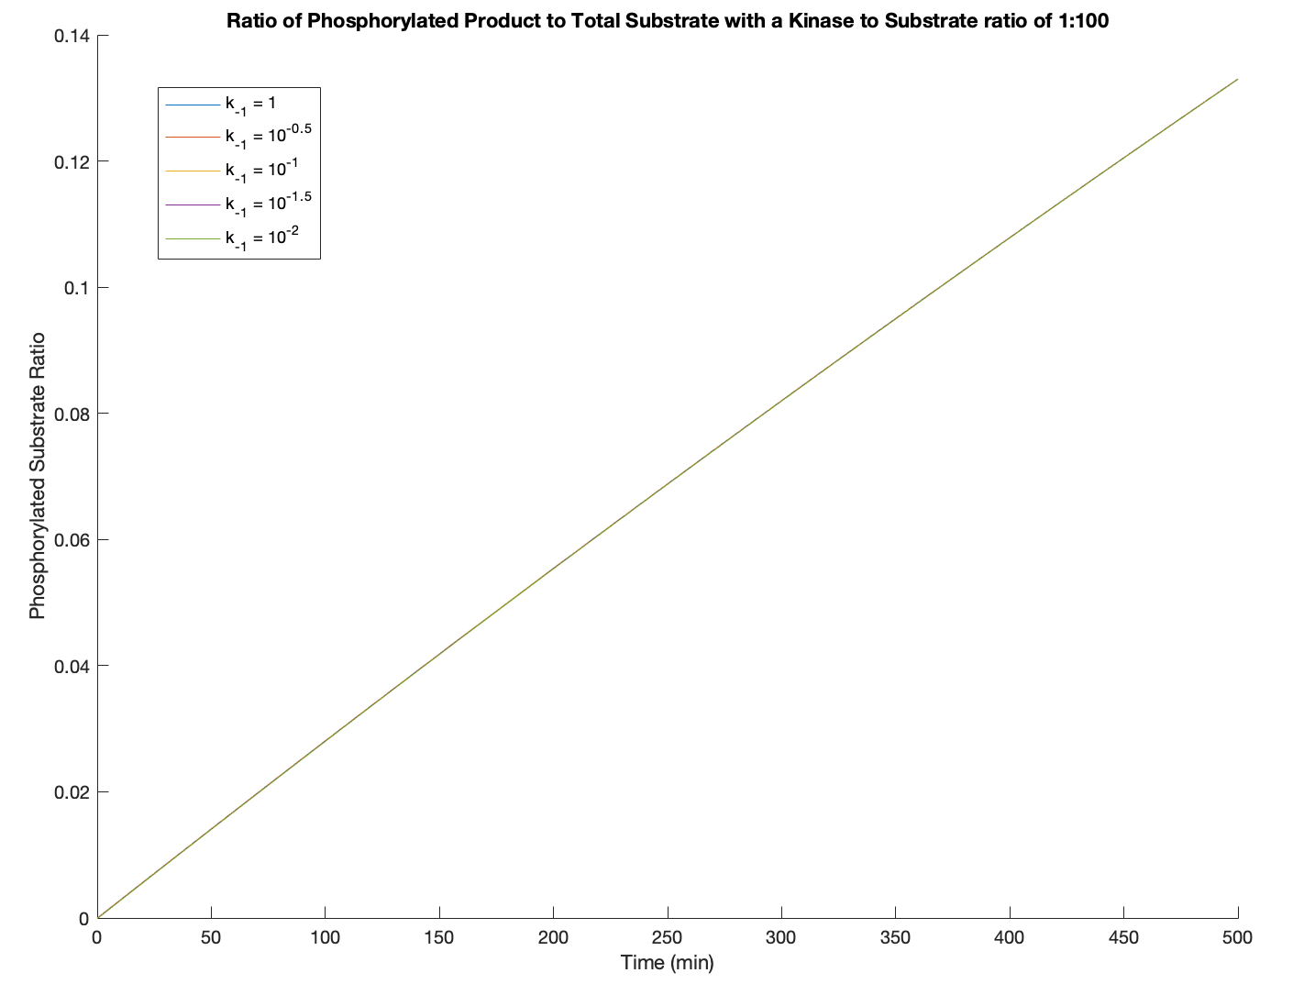
No changes in plot produced when k₋₁ and k₋₂ are changed

Slide 9
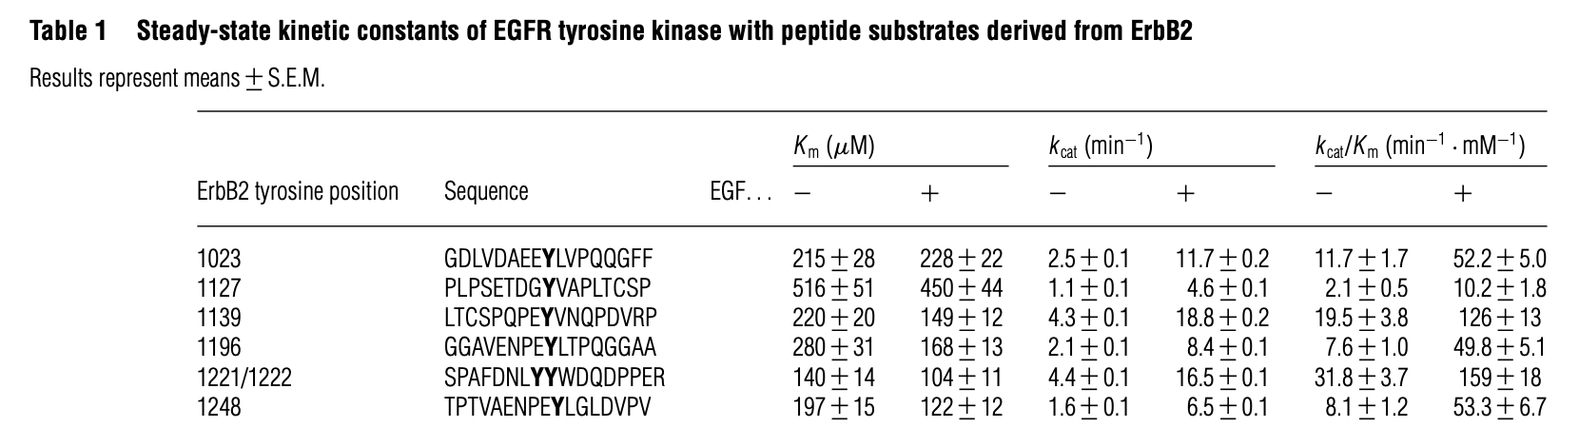
Specificity
Encoded using K_{m} and k_{cat} using the specificity constant
Specificity = k_{cat}/K_{m}
Higher values for specificity → the kinase is more specific
Fan et al. (2005)

Slide 10
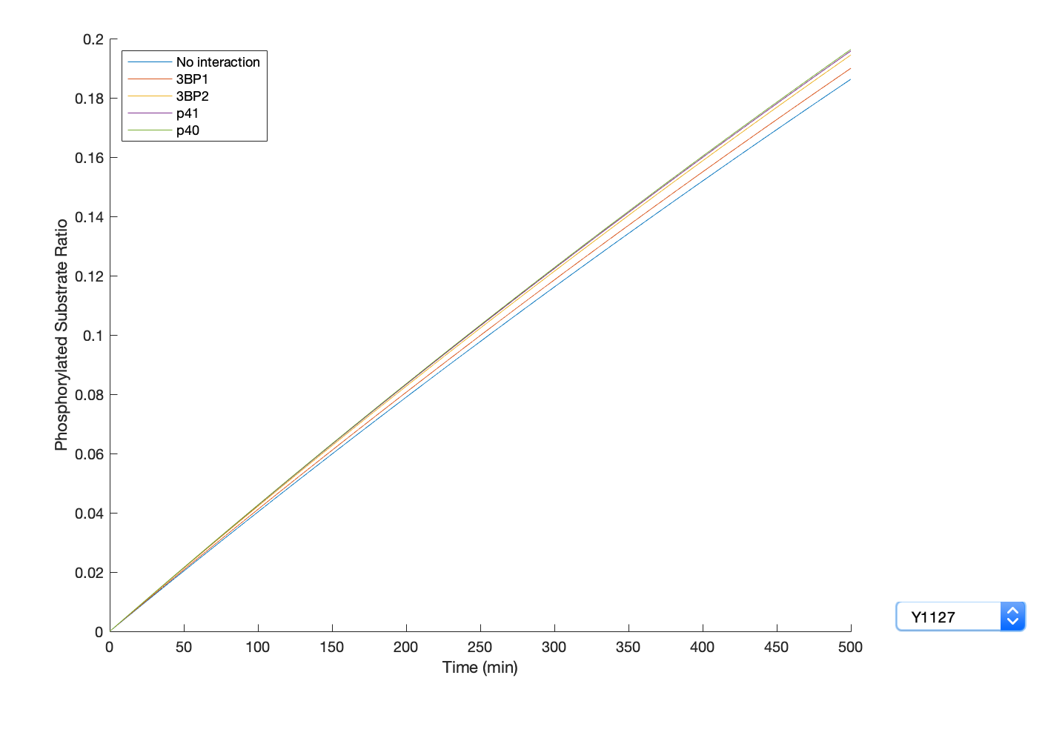
ErbB2 site: Y1127
K_{m} = 516 uM
k_{cat} = 1.1 min⁻¹
k_{cat}/K_{m} = 2.1 min⁻¹mM⁻¹

Slide 11
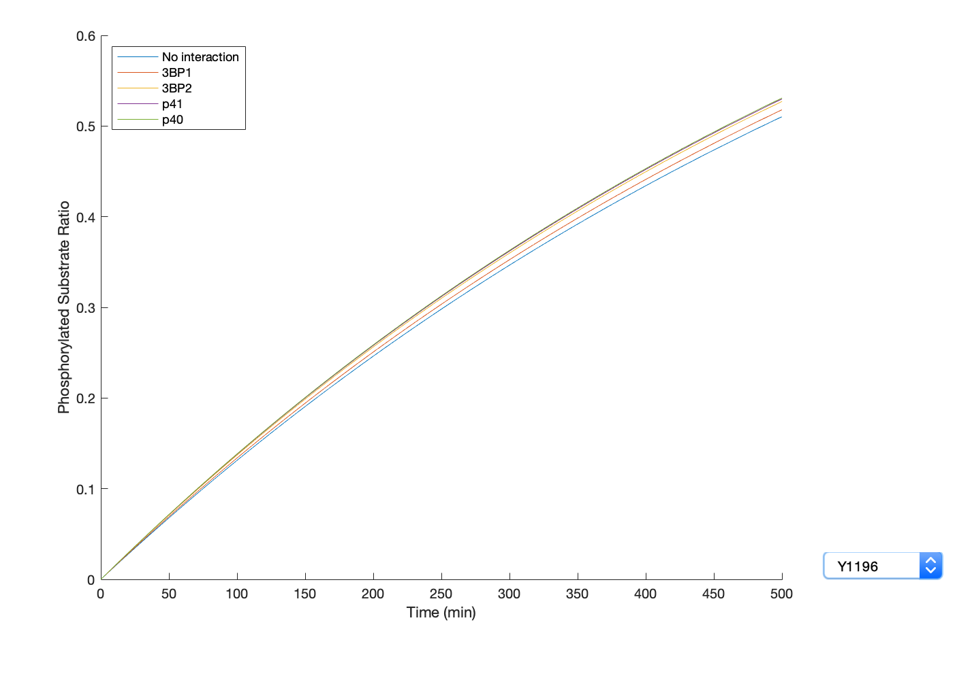
ErbB2 site: Y1196
K_{m} = 280 uM
k_{cat} = 2.1 min⁻¹
k_{cat}/K_{m} = 7.6 min⁻¹mM⁻¹

Slide 12
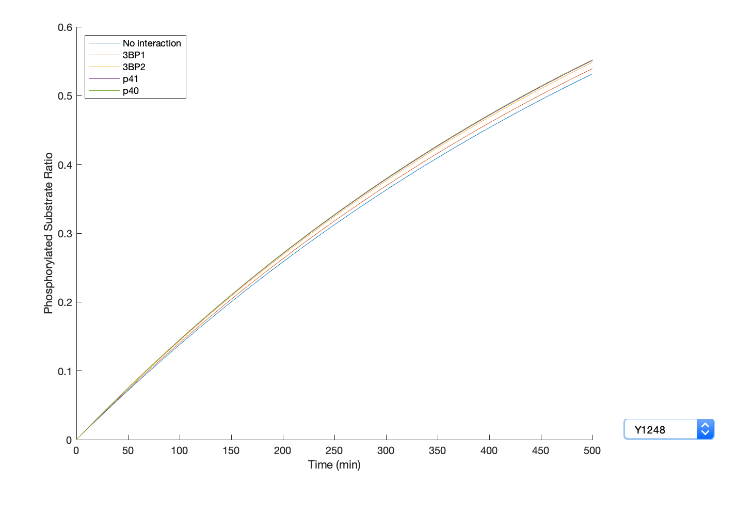
ErbB2 site: Y1248
K_{m} = 197 uM
k_{cat} = 1.6 min⁻¹
k_{cat}/K_{m} = 8.1 min⁻¹mM⁻¹

Slide 13
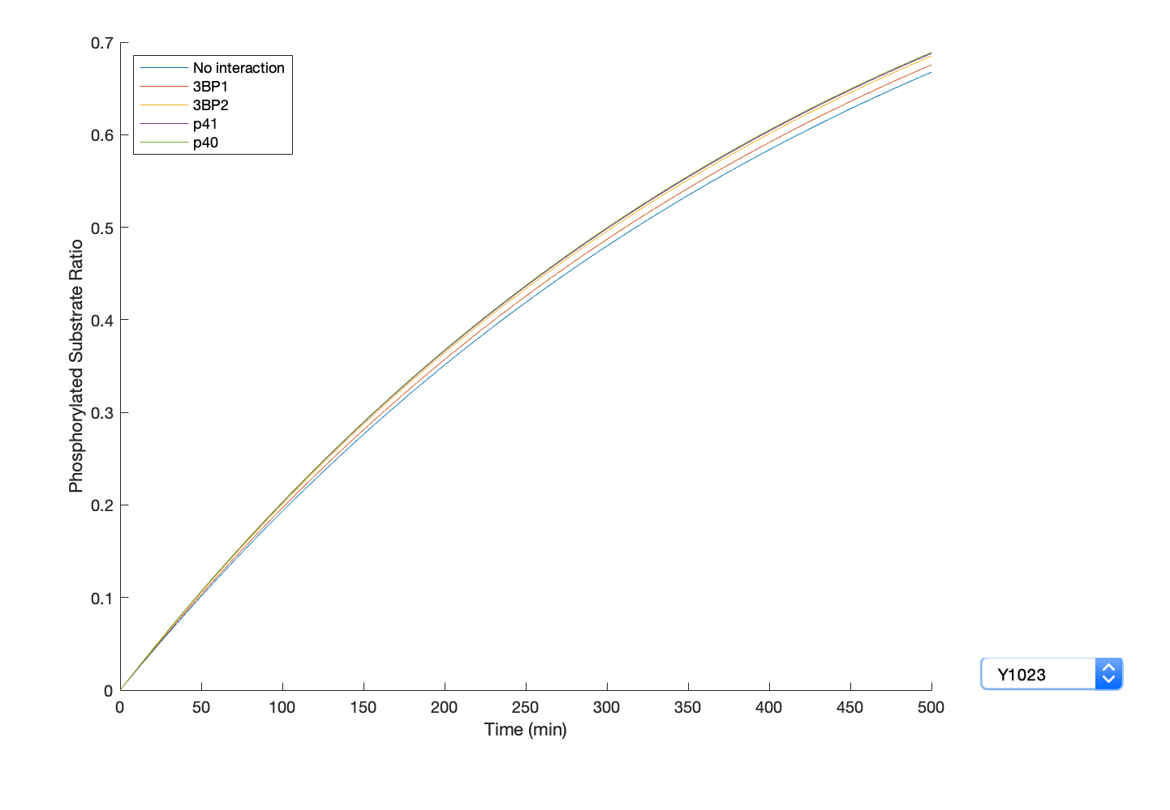
ErbB2 site: Y1023
K_{m} = 215 uM
k_{cat} = 2.5 min⁻¹
k_{cat}/K_{m} = 11.7 min⁻¹mM⁻¹

Slide 14
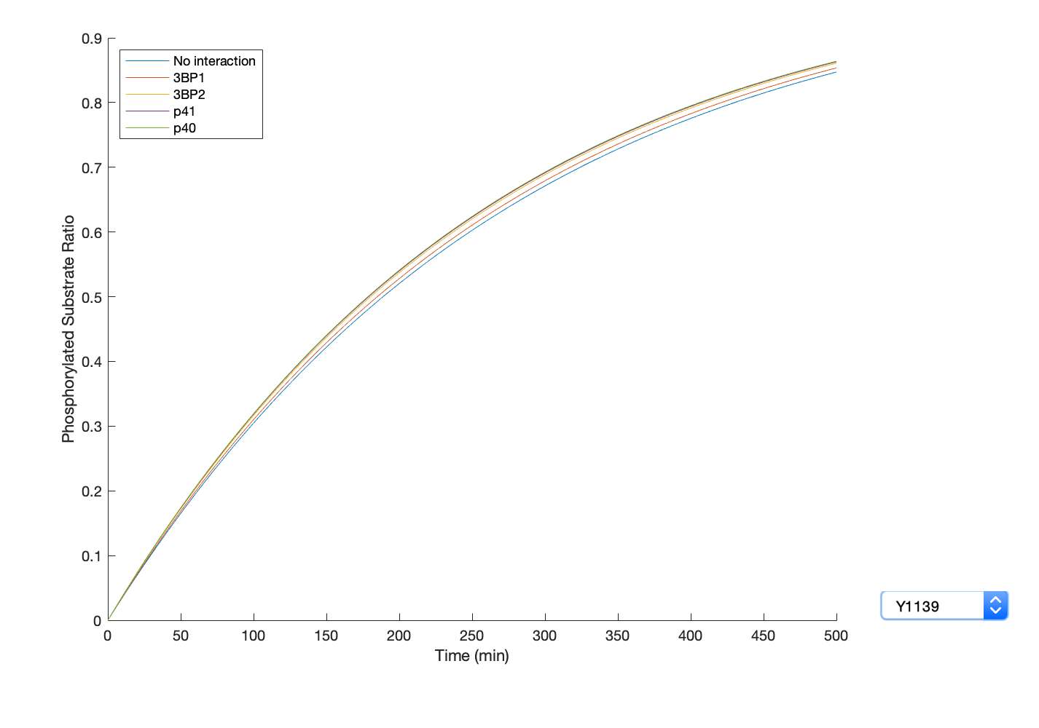
ErbB2 site: Y1139
K_{m} = 220 uM
k_{cat} = 4.3 min⁻¹
k_{cat}/K_{m} = 19.5 min⁻¹mM⁻¹

Slide 15
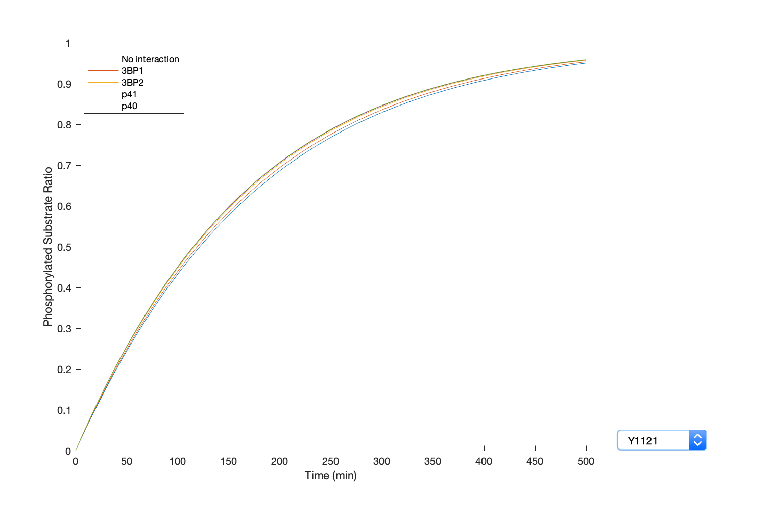
ErbB2 site: Y1121/1122
K_{m} = 140 uM
k_{cat} = 4.4 min⁻¹
k_{cat}/K_{m} = 31.8 min⁻¹mM⁻¹

